Slide 1
Physical Structure, Components and real-world applications of Arduino

Slide 2
Introduction to Arduino
Arduino is an open-source hardware and software company, project and user community that designs and manufacture single-board microcontrollers and microcontroller kits for building digital devices.
It is an open-source electronics prototyping platform based on easy-to-use hardware and software.
Arduino is written in C++ with some additional of specific methods and functions.
Arduino is simple a programmable microcontroller. It does not have RTOS when compared to other computer systems.
There are variety of Arduino boards such as Arduino UNO, Arduino Nano, Arduino Mega, e.t.c

Slide 3
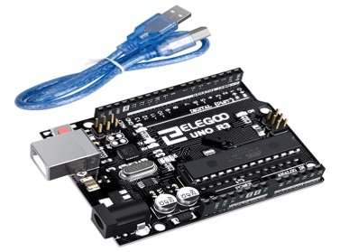
Arduino UNO board

Slide 4
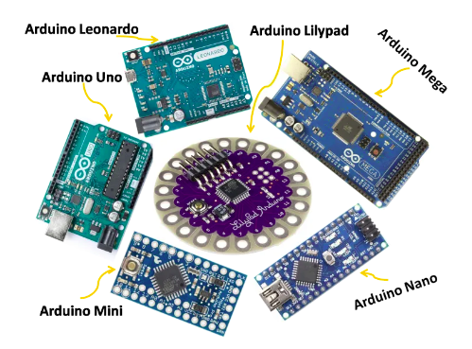
Different types of Arduino Boards

Slide 5
Differences of the Arduino Boards
Arduino Board | Core Unit | Memory, SRAM, EEPROM | Digital I/O | Analog I/O
Arduino UNO | 16MHz, ATmega328 | 2KB SRAM, 1KB EEPROM, 32KB Flash | 14 | 6 inputs, 0 output
Arduino DUE | 84MHz, AT91SAM3X8E | 96KB SRAM, 512KB Flash | 54 | 12 inputs, 2 outputs
Arduino Mega | 16MHz,ATMEGA2560 | 8KB SRAM, 4KB EEPROM, 256KB Flash | 54 | 16 inputs, 0 output
Arduino Leaonardo | 16MHz, ATMEGA32U4 | 2.5KB SRAM, 1KB EEPROM,32KB Flash | 20 | 12 inputs, 0 output

Slide 6
Arduino Components
The major components of Arduino UNO board are as follows:
USB Connector
Power port
Microcontroller
Analog input and Digital pins
Reset switch
Crystal oscillator
USB interface chip
TX RX LEDs

Slide 7
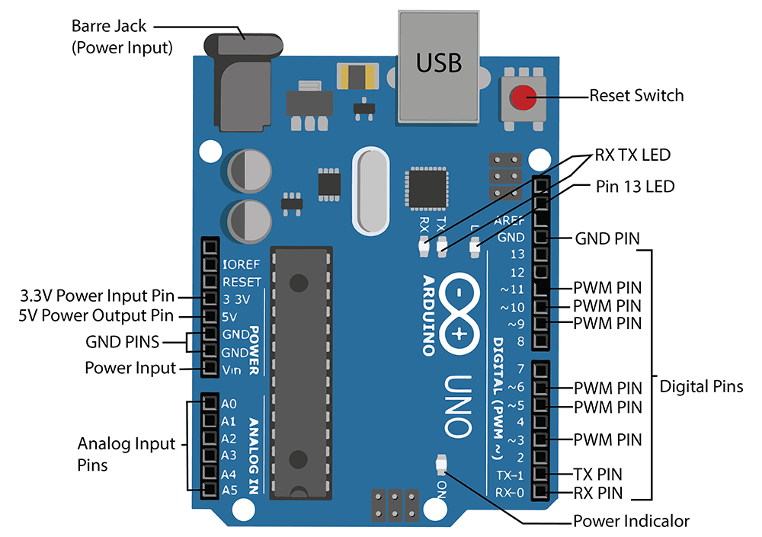
Arduino UNO pins description

Slide 8
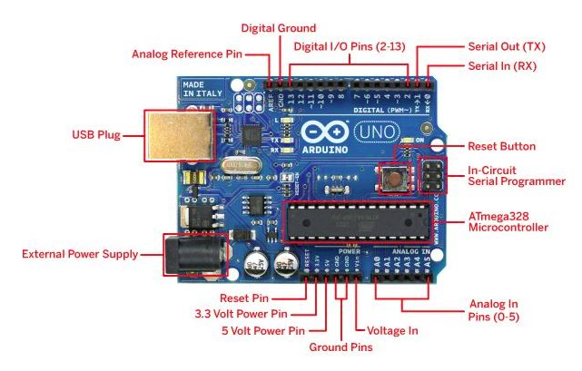
Arduino UNO parts description ….

Slide 9
Real-world Applications of Arduino
With the Arduino board we can control the Home, Office and Industrial activities with the control systems such as motion sensors, outlet control, temperature sensors, blower control, garage door control, air flow control and many others.
Arduino can be used in many industrial control and automation systems.
Using different top technologies like AI, ML, IoT and many others, we can interface an Arduino board to produce more and more intelligent devices and systems.
Arduino is an open-source, it is just an electronics prototyping board.

Slide 10
Must-have Tools ….
Simulation software (e.g Proteus, Fritzing)
Circuit designing tools (e.g Fritzing, Proteus, LibrePCB)
Arduino IDE (very important)
Arduino Kit

Slide 11
Simulation of Arduino Projects
A number of tools are used to simulate Arduino circuits
Proteus Profession configured with Arduino Libraries
Licensed Fritzing
Online tools such as Tinkercad from https://www.tinkercad.com
Blinking an LED.

Slide 12


